Slide 2
TCShell
Script Mode
Interactive mode
Open CMD
Go to Tcshell.exe folder
C:\Program Files (x86)\TRICENTIS\Tosca Testsuite\ToscaCommander
Tsshell.exe –workspace “First Steps” –login “admin” “”
Enter
Jumptonode Execution list name
Run Task
Save
C:\Program Files (x86)\TRICENTIS\Tosca Testsuite\ToscaCommander>tcshell -workspace "C:\Tosca
_Projects\Tosca_Workspaces\test\test.tws" -login "admin" ""

Slide 3
Script mode
Open notepad
Save as .tcs file
Enter below command lines
adminModusOn
jumptonode "/Execution/ExecutionLists/testexecutionl"
task Run
save

Slide 4
TDM
In this TDM use case:
Process 1: Creates new data and registers it into TDM
Process 2: Retrieves and uses the data then modifies the data in TDM
Process 3: Retrieves and uses the data and makes further modifications in TDM

Slide 5
TDM
Use the TestCase-Design section to create a Schema
Use the created Schema to create TDM Modules
Create new test data in the SuT with Tosca automation
Register test data in TDM using the created TDM Modules
Update test data in TDM using the created TDM Modules
Use TDM Test Data in the SuT with Tosca automation
Retrieve test data from TDM using the created TDM Modules
Copy DLL in to C:\Program Files (x86)\TRICENTIS\Tosca Testsuite\ToscaCommander

Slide 6
TDM
Tosca’s TDM supports the following types of databases:
• MS SQL Server
• DB2
• Oracle
• SQLite
We will be using an SQLite database for the purpose of this training
MS SQL Server (server=localhost;database=test;uid=test;pwd=12345)
• DB2 (server=localhost;database=default;uid=test;pwd=12345)
• Oracle (Data Source=test;User Id=test;Password=12345;)
• SQLite ("C:\TDM\tdmdatabase.db)

Slide 7
TDM
Before continuing you will need to complete the following tasks:
Download and install the TDM AddOn.
Download and save the SQLite database file.
The Test configuration parameter must have the Name “TDMConnection”
The Value entered will specify the type of database and the location of your database (Example:
SQLite(C:\TDM\TDM_Demo.db)
The Test configuration parameter must be not only be specified in TestCase-Design, but in
every other section of Tosca which uses TDM.
In order for the TDM AddOn to work, it is necessary to define the Test configuration parameter
on the highest possible level (e.g. Project level)*
This ensures also that all the sections below will inherit the Test configuration parameter.
Examples: Once again, here are some examples of connection strings, which can be entered as
a Value for a Test configuration parameter for other databases:
MS SQL Server (server=localhost;database=test;uid=test;pwd=12345)
DB2 (server=localhost;database=default;uid=test;pwd=12345)
Oracle (Data Source=test;User Id=test;Password=12345;)
{TDM[tabname.colname]}

Slide 8
TQL
What is TQL
TQL is a powerful search tool that allows you complex, section combining searches
The starting point and the used arrow operator define the outcome of the search
Queries can be saved in Virtual Folders
Why TQL?
Syntax
query ::= {arrowOperator [returnToken] searchExpression}
->SUPPARTS:Module
=>SUBPARTS:TestCase

Slide 9
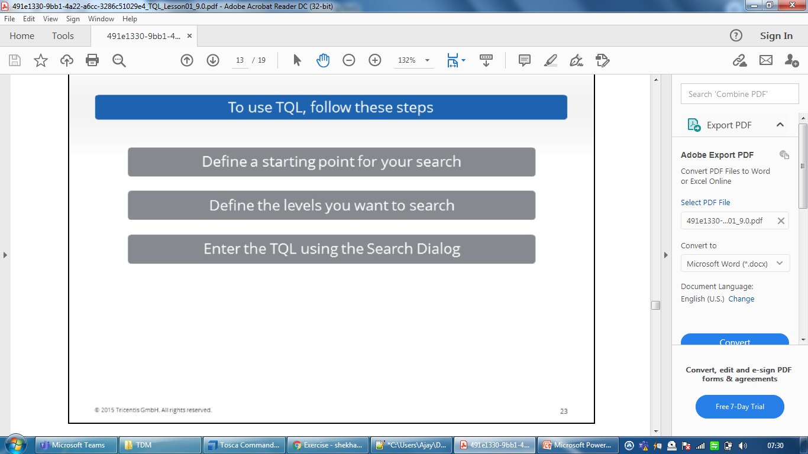
TQL

Slide 10
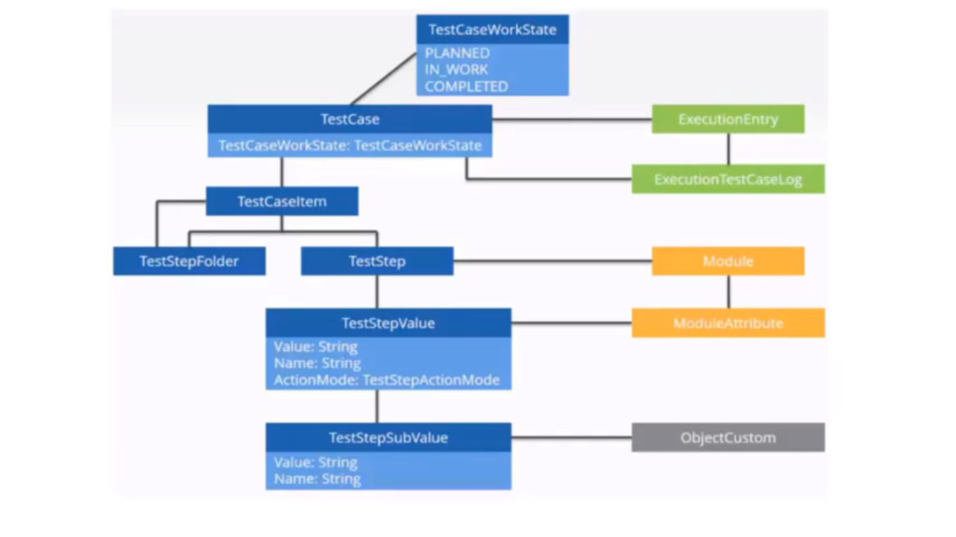
Tosca object model

Slide 11
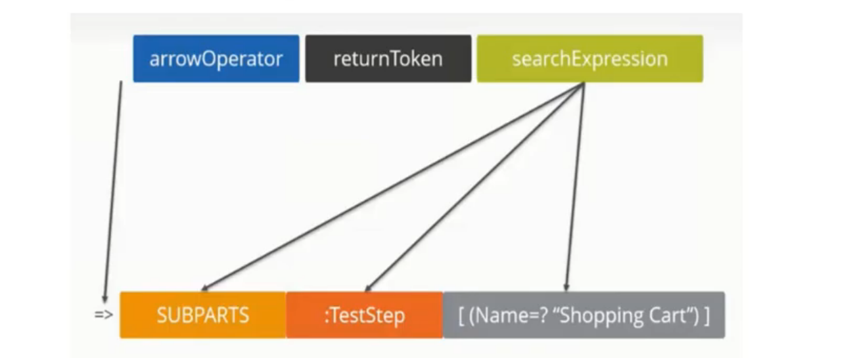
Structure of query

Slide 12
Operators
==
!=
=?
<
>
<=
>=
=i= case insensitive
=> is right part contain left part
Relational Operators
AND
OR

Slide 13
Functions
UNION
Intersections
Complement
Count
SORT
EVALCP
SUBSET

Slide 14
BASIC TQL
=>SUBPARTS:TestCase[TestCaseWorkState==“COMPLETED”]
we search the Subparts of the Test Cases Section for Test Cases that have the Test Case Work State Completed
=>SUBPARTS:TestCase[IsTemplate==“FALSE” AND TestCaseWorkState==“COMPLETED” AND Count(“ExecutionEntries”)==“0”]
search the for TestCases that have the TestCaseWorkState Completed and are not linked to an Execution List yet
The query consist of three parts:
It checks for TestCases that are not Templates AND
They must have the TestCaseWorkState COMPLETED AND
The count for Execution Entries for them must be 0

Slide 15
=>SUBPARTS:TestCase[IsTemplate==“False” AND TestCaseWorkState!=“COMPLETED” AND Count(“ExecutionEntries”)>”0”]
Search the for TestCases that do not have the TestCase WorkState Completed but are linked to an ExecutionList
The query consist of three parts:
It checks for TestCases that are not Templates AND
They must not have the TestCase WorkState COMPLETED AND
The count for ExecutionEntries for them must be greater than 0

Slide 16
=>SUBPARTS:Xmodule[Count(“TestSteps”)==“0”]
Example we search the Subparts of the Modules Section for XModules that are not used as TestSteps
=>SUBPARTS:Xmodule[(IsTboxModule=?”True”)]

Slide 17
Test Mandates
In a multiuser workspace, several testers should be able to execute the same tests simultaneously. They should also be able to execute these tests independently, so as to not overwrite other testers' results.
You can facilitate this by working with TestMandates. In this case, each tester creates a TestMandate in their own workspace and links it to a test object:
ExecutionList folders
ExecutionLists
ExecutionEntry folders
ExecutionEntries
Once testers have done so, they execute the TestMandate and not the original test object. Tosca Commander then writes the results to the ActualLog of the TestMandate and the ActualLog of the test object.
The ActualLog of the test object consolidates the results of all linked TestMandates once testers checkin their workspace

Slide 18
TDS
Tricentis Tosca Test Data Service is a web-based application which enables you to manage your test data in distributed environments.
Installation
Tosca Server
IIS
Imp: Same version of tosca commander as well as Tosca server required
Open service confguration and configure all the connect an port no

Slide 19
In Tosca Commander
Go to Configuration section
2 TCP- EDN point URL(http://localhost:8089/TestDataService/)
Repository name-testdb
Accessing TDS
Go to Tosca Server URL
Then click on Testdatamanagement tab
Then check the Repositoreis(DBname) if created or create manually
And there tables(tds type) and values

Slide 20
DB Module
The test sequence consists of three major steps:
Establishing a database connection
Database operations
Closing the database connection
DB Modules are located in the folder Standard modules->TBox XEngines->Database.
JDBC Connection
ODBC Connection (Control panel) userid password DSN Name
MSSQL
SQLlite
ORACLE
Input for DB connection-ODBC- Data sourcename(DSN), Username,password
Connection String

Slide 21
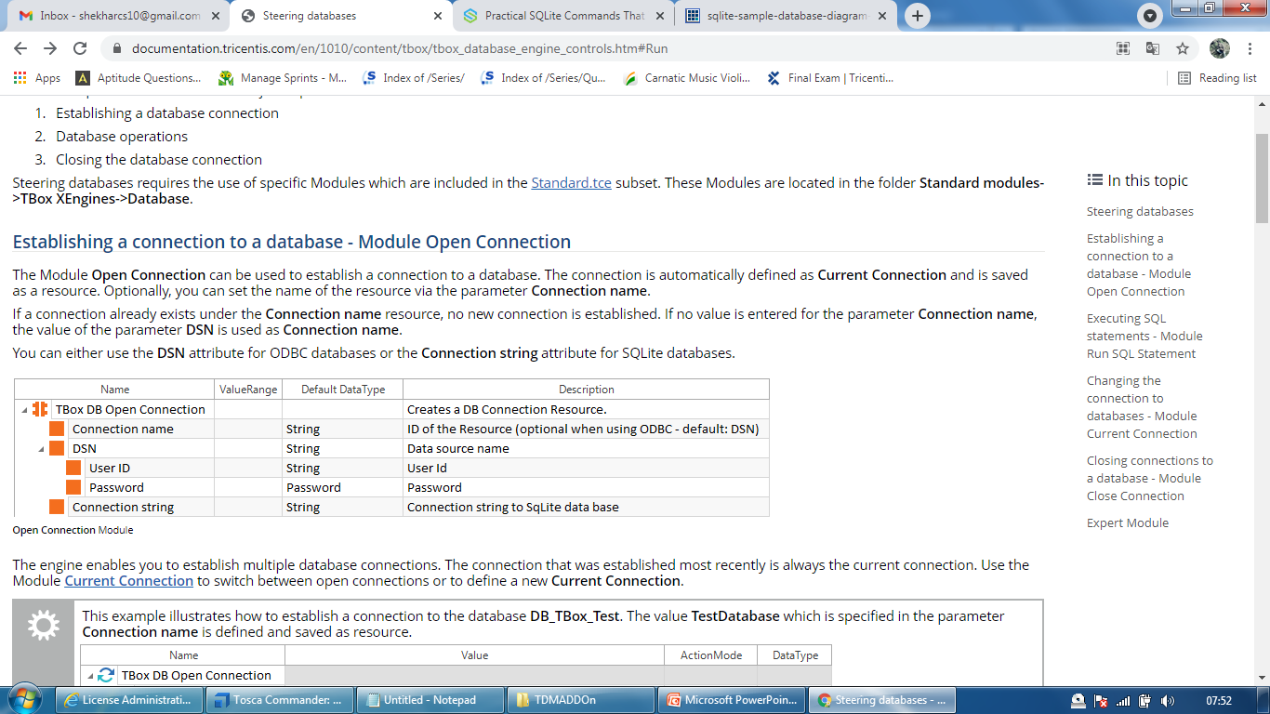
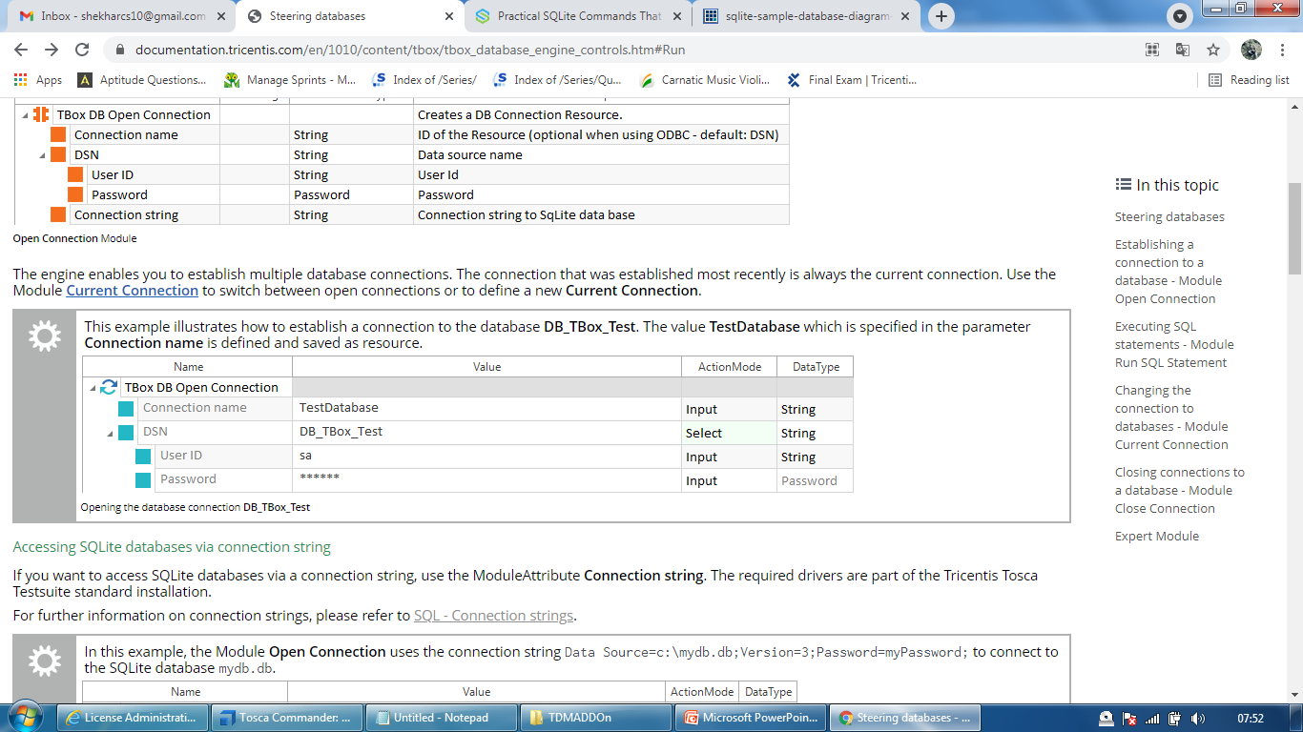
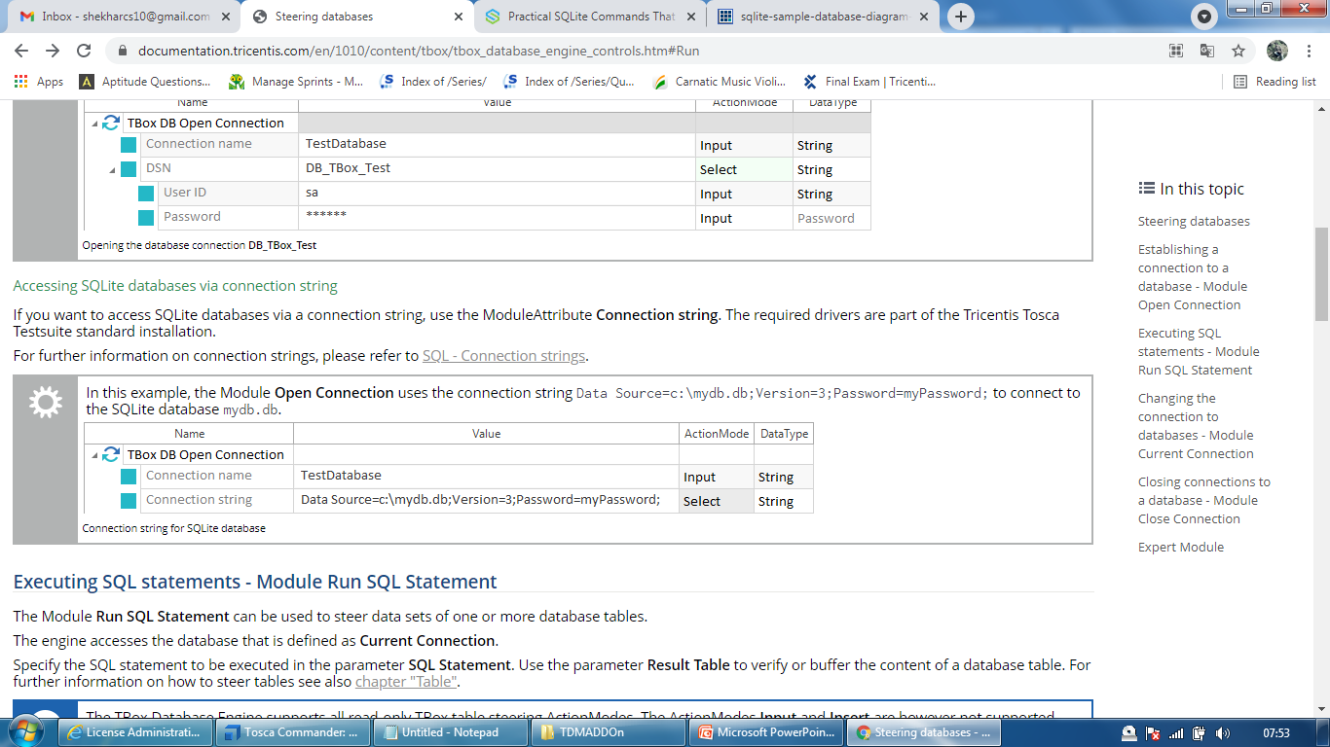
Open Connection

Slide 22
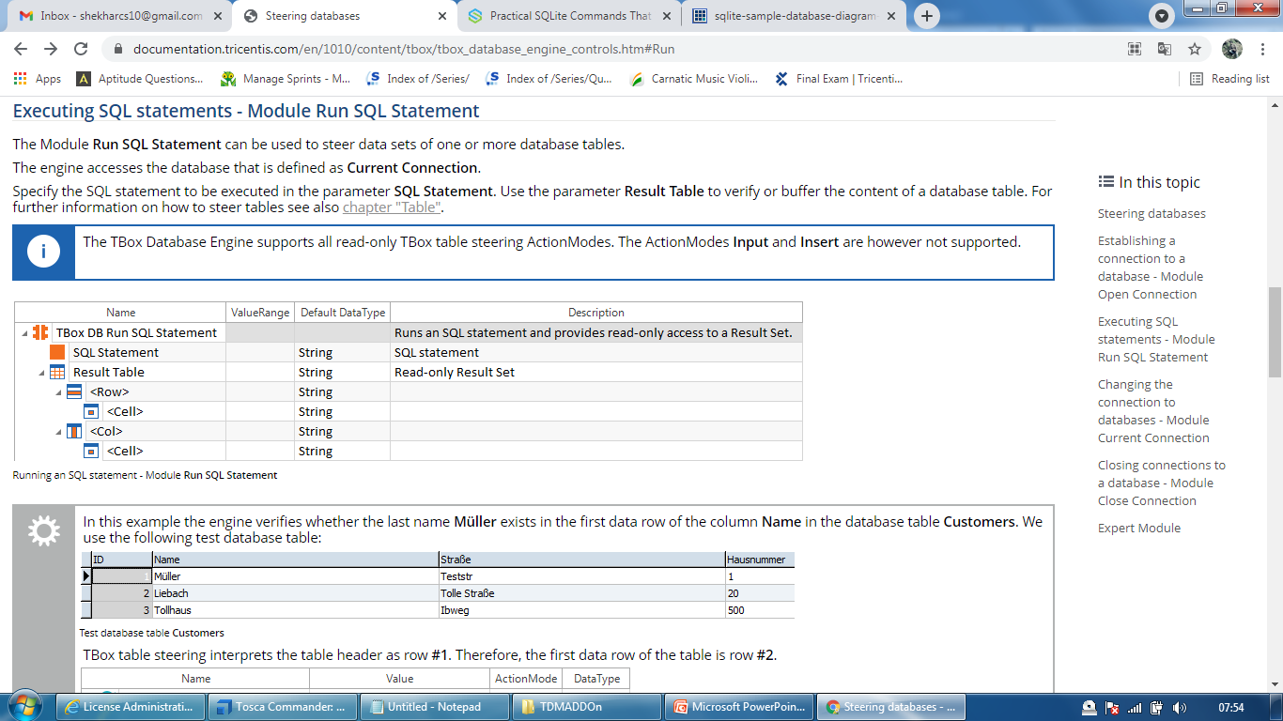
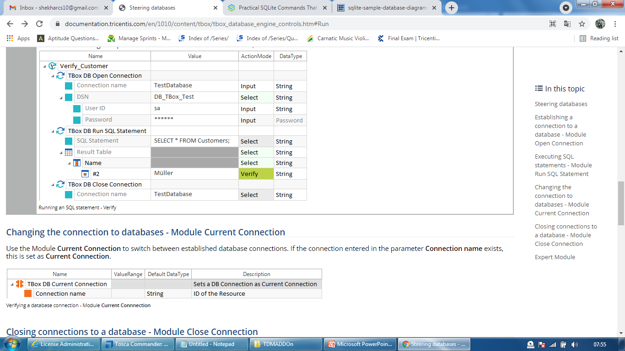
Run SQL Commands

Slide 23
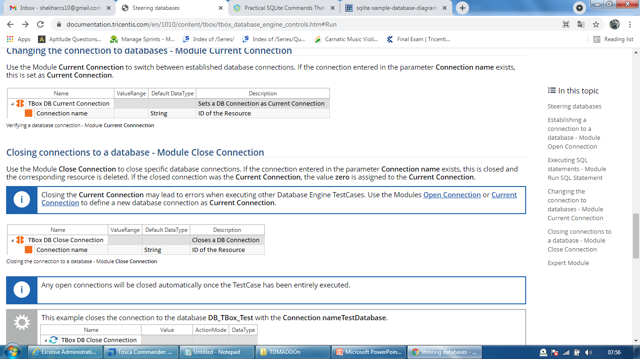
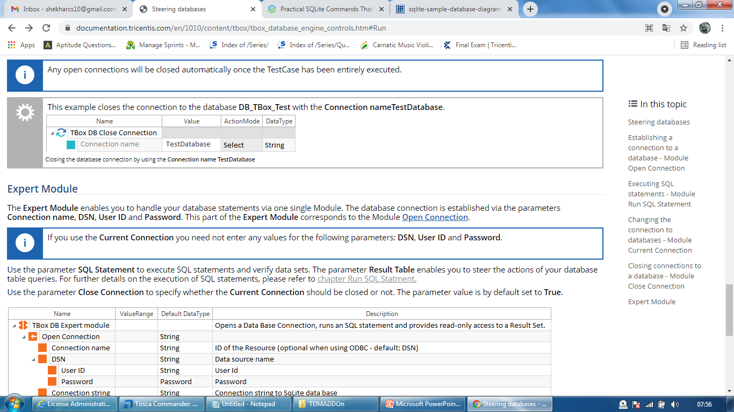
Close Connection

Slide 24
ALM

Slide 25
SAP FIORI
https://documentation.tricentis.com/tosca/1340/en/content/engines_3.0/sap_webextension/sap_fiori_controls.htm

Slide 26
SAP ECC
https://documentation.tricentis.com/tosca/1340/en/content/engines_3.0/sap/sap_modules.htm

Slide 27
SAP Successfactor
https://documentation.tricentis.com/tosca/1340/en/content/engines_3.0/sap_webextension/sap_successfactors_controls.htm

Slide 28
Scan mobile applications
Ensure that you have prepared your test environment. For detailed information, see the following links:
Prepare Android test automation
Prepare iOS test automation
Start the Mobile Scan and connect to your device.
Add a mobile device, emulator, or simulator. This step is optional.
Add a mobile application. This step is optional.
Select controls you want to steer.
Scan a different screen, application, or device. This step is optional.
Configure advanced options in the Mobile Scan. This step is optional.
Configure Desired Capabilities.
Configure the Mobile Scan for devices in Perfecto.

Slide 29
Prepare Android test automation
Test automation on an Android device or emulator requires the following components:
Mobile Engine 3.0 components which are included in the Tricentis Tosca standard installation.
A computer with Tricentis Tosca on it.
If you want to perform mobile test automation via a Mac, you need Xcode, Java, and Appium installation on your Mac.
An Android device or emulator.
To automate Android hybrid and web applications, you have to update Chromedriver to the newest version.
Additionally, for local Android devices, you need the following components:
Android SDK Tools on your Windows computer or a Mac.
Java 8 installation.
Environment variables
USB cable and a USB driver to connect the device to a computer with Tricentis Tosca or a Mac.
For detailed information on installing drivers for Samsung devices, refer to the Tricentis Knowledge Base.

Slide 30
Start the Mobile Scan and connect to your device
Go to tosca Commander
Go to module section
Right click on module folder and Select Scan->Mobile
Mobile Scan will launch
Add Android devices
Add Application
Native
Hybrid
For IOS
For Android

Slide 31
https://documentation.tricentis.com/tosca/1340/en/content/engines_3.0/mobile/tbox_mobileweb_android.htm
Add a mobile device, emulator, or simulator.

Slide 32
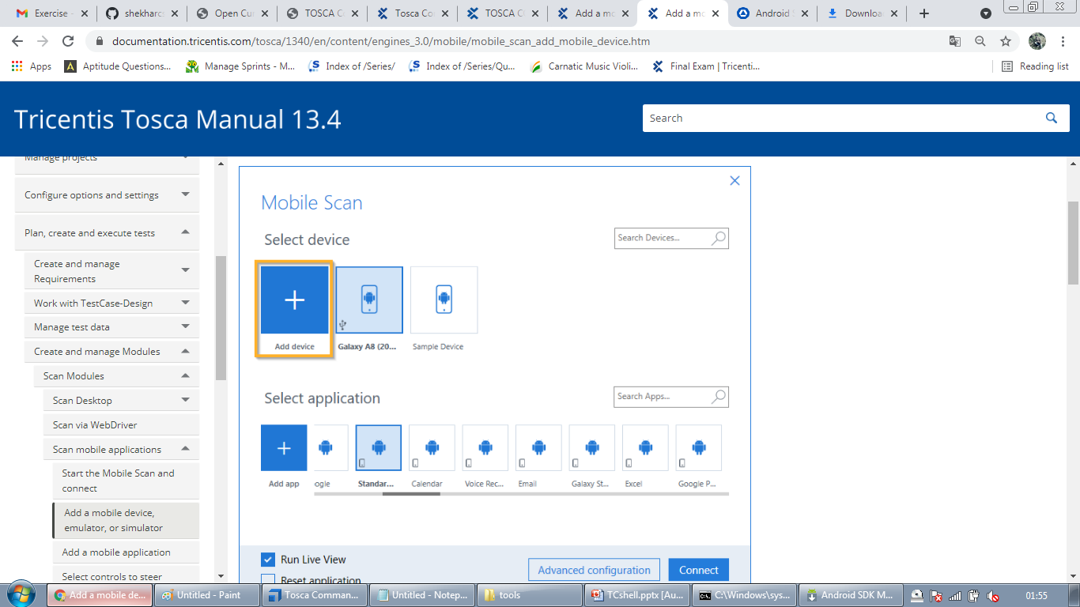

Slide 33
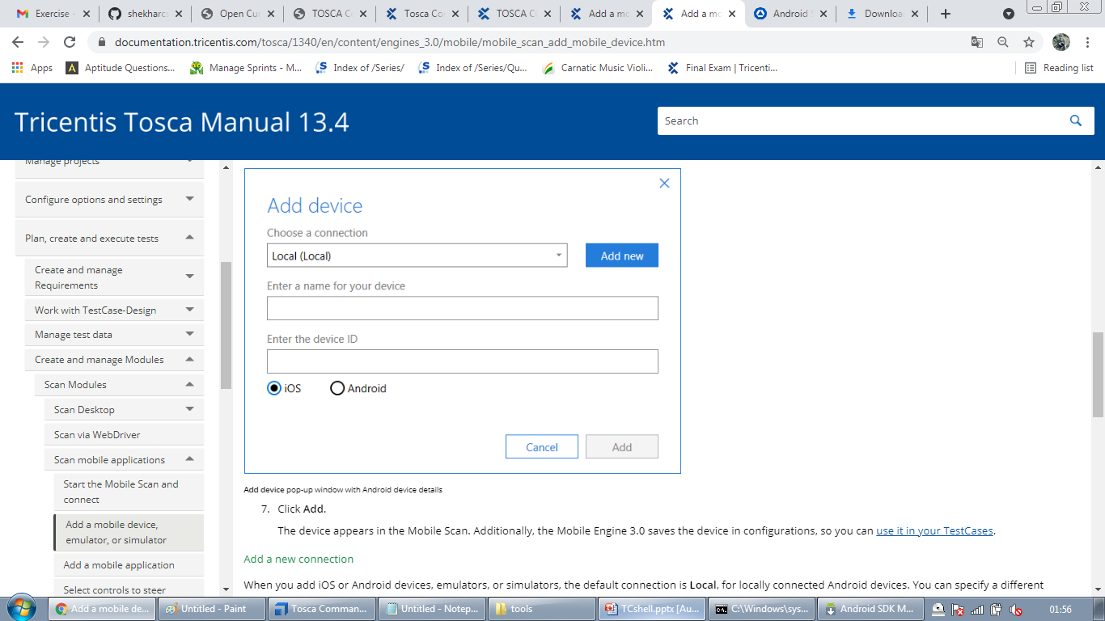

Slide 34
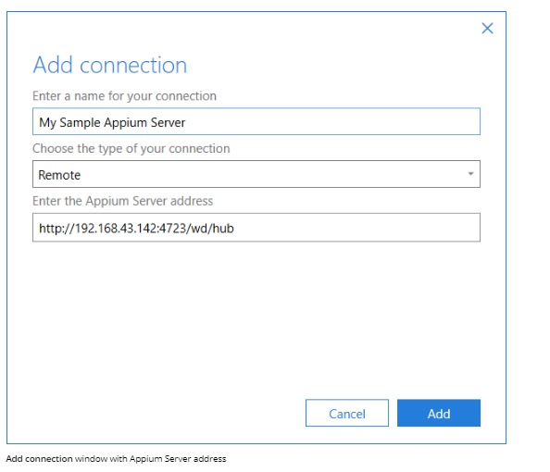

Slide 35
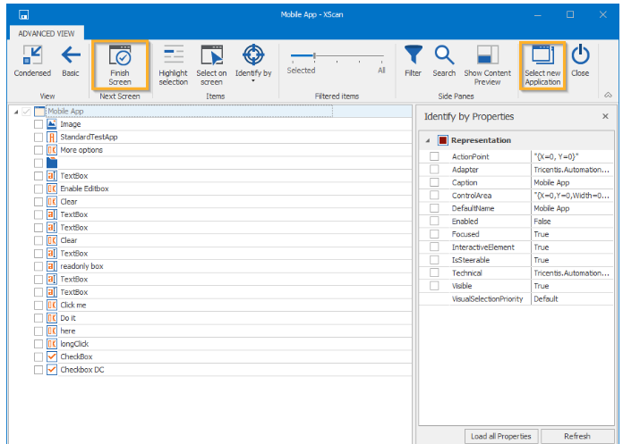
Select controls you want to steer.

Slide 36
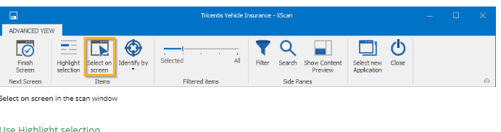

Slide 37
